Slide 1

Advance Manufacturing Project:-
Machinability Analysis in Ball End Milling of Ti6Al4V Alloy
LAV KUMAR SINGH (221030012009)
MAHAK CHAUHAN (221030012010)
MOHAMMAD UMAR (221030012011)
JATIN GURJAR (221030012008)
Course Co-ordinator
Dr. Mithilesh Dikshit

Slide 2
Introduction
Titanium alloys are widely used in aerospace, biomedical, and automotive industries due to their exceptional strength-to-weight ratio, high corrosion resistance, and excellent biocompatibility. However, these properties also pose significant challenges during machining, such as high cutting temperatures, rapid tool wear, and poor machinability.
This analysis focuses on understanding the performance of ball end mills in machining titanium alloys. It evaluates :-
TOOL WEAR (Upto Vc i.e.0.3mm)
Surface Roughness
Power
under fix operating conditions including Cutting speed, feed rate, and depth of cut.

Slide 3
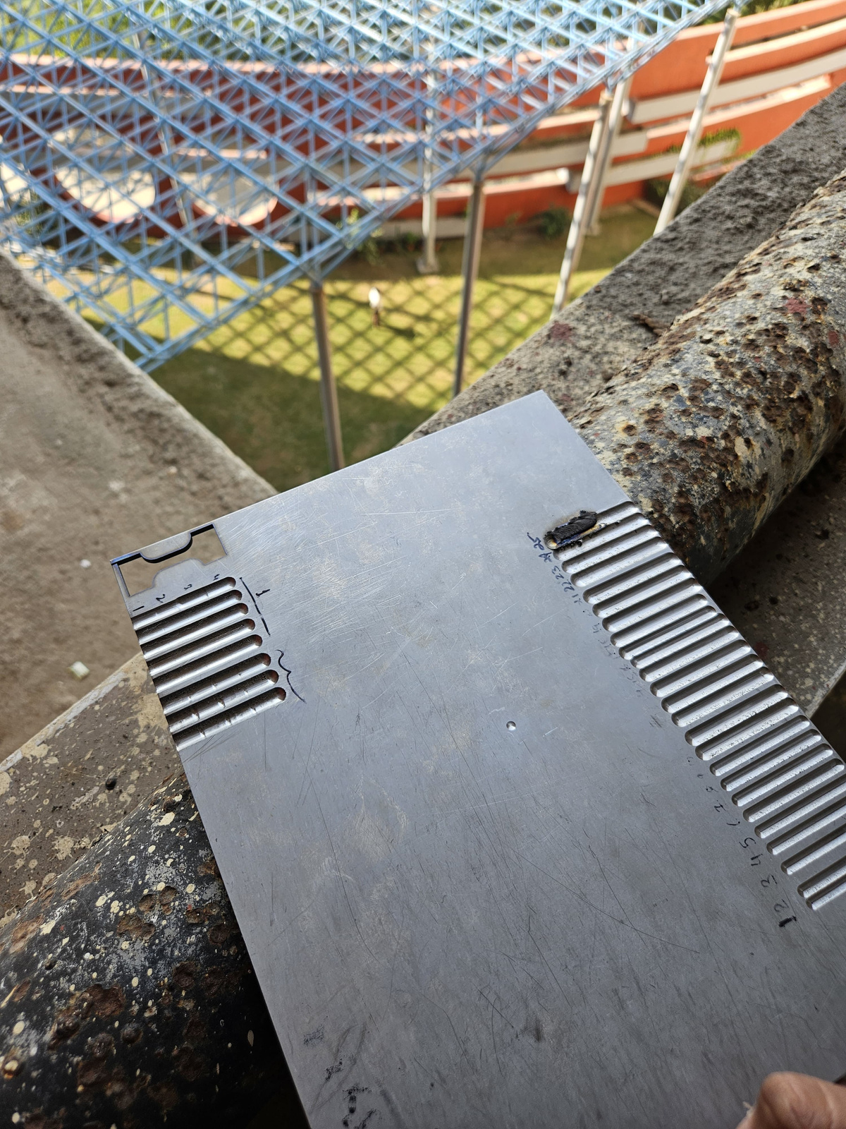
Ti-6Al-4V
Ti-6Al-4V is the most commonly used titanium alloy, accounting for over 50% of all titanium alloy applications. Its popularity spans industries like aerospace, medical, automotive, and
marine due to its :-
High strength-to-weight ratio
Corrosion Resistance
Biocompatibility
Machining Challenges
Low thermal conductivity
Increased Ductility
Rapid tool wear
Fig. 1

Slide 4
BALL END MILLING
Tool Geometry: Ball end mills feature a hemispherical tip that enables
multi-axis machining of complex 3D surfaces.
Material: Tungsten carbide (providing Durability, resistance to wear at high temp.)
Surface Finish: Produce Smooth finishes on 3-d surfaces
Helix Angle: 30° helix angle, providing a balanced combination of cutting performance and smooth material removal.
Diameter: Cutting Diameter of 8 mm.

Slide 5
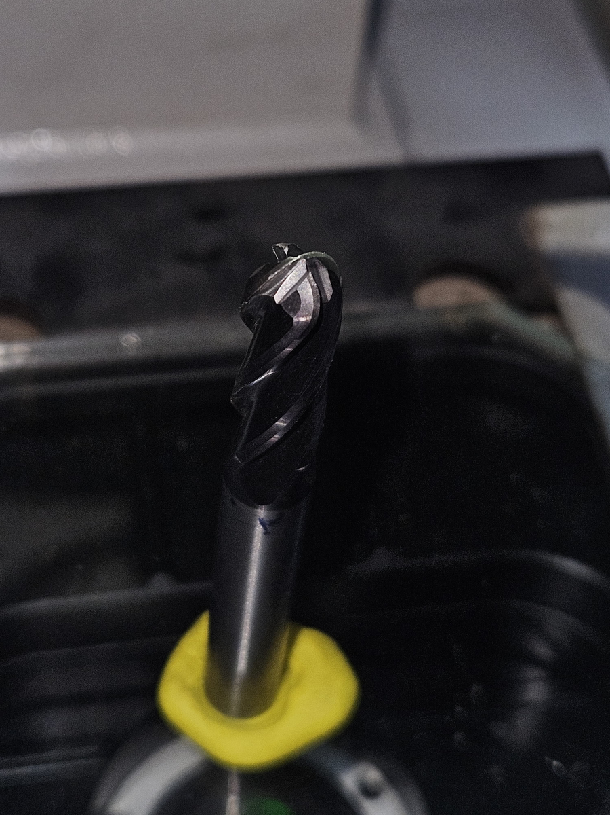
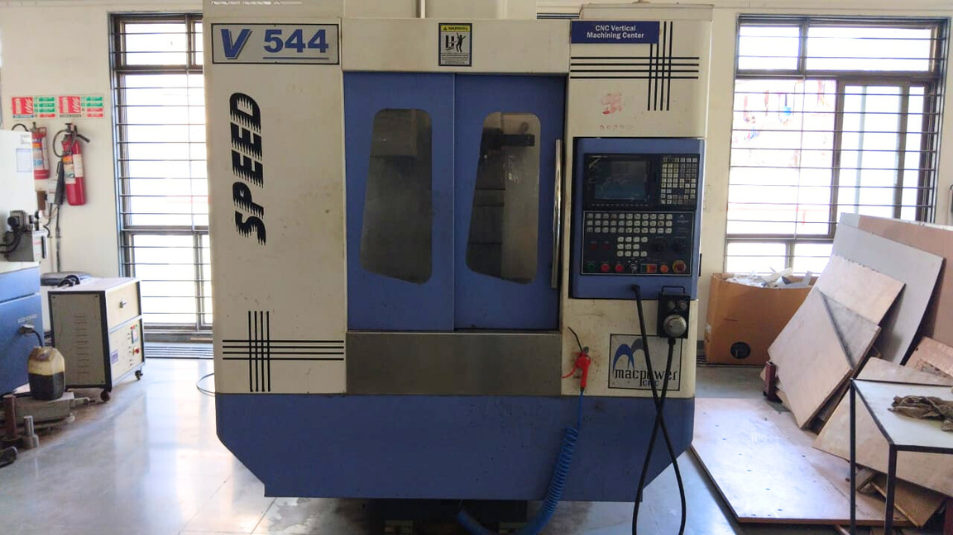
Ball End Mill Tool
VMC Machine
Fig. 2
Fig. 3

Slide 6
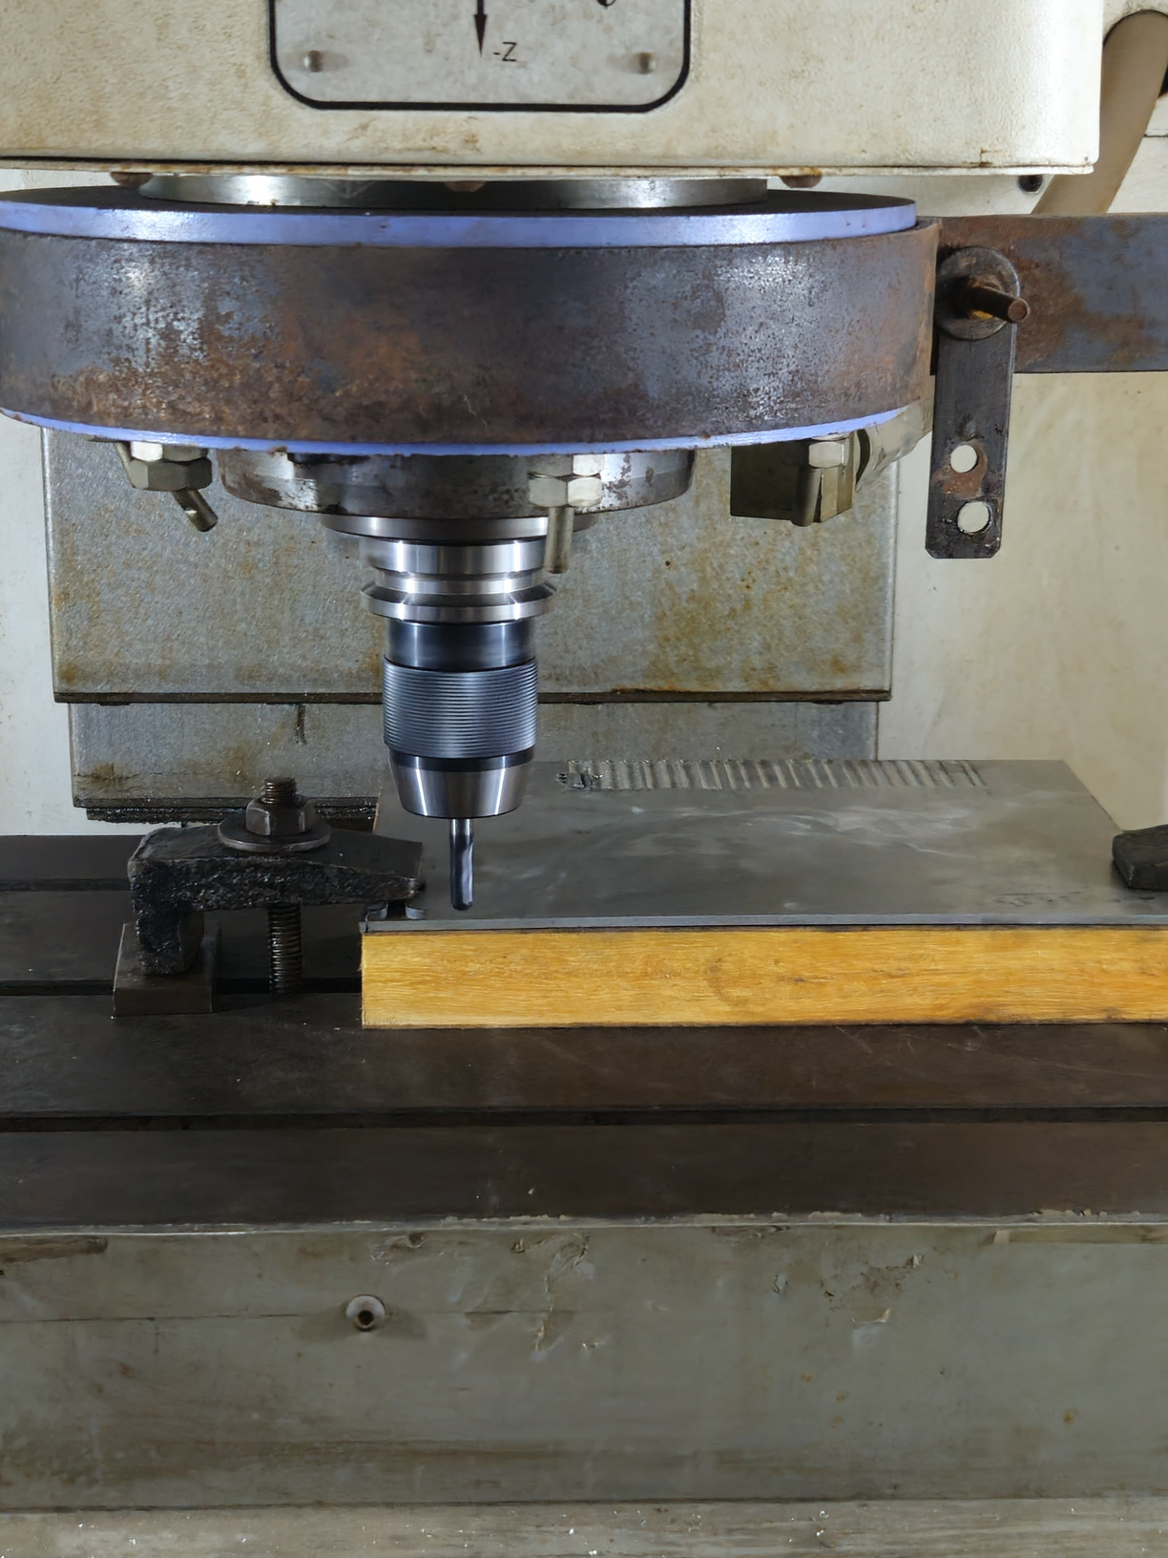
1- Process Parameter :-
Feed per tooth : 0.05 mm/tooth
Depth of cut : 0.8 mm
RPM: 4380
2-Process Parameter :-
Feed per tooth : 0.2 mm/tooth
Depth of cut : 1.1 mm
RPM: 6000
Machining
Fig. 4

Slide 7
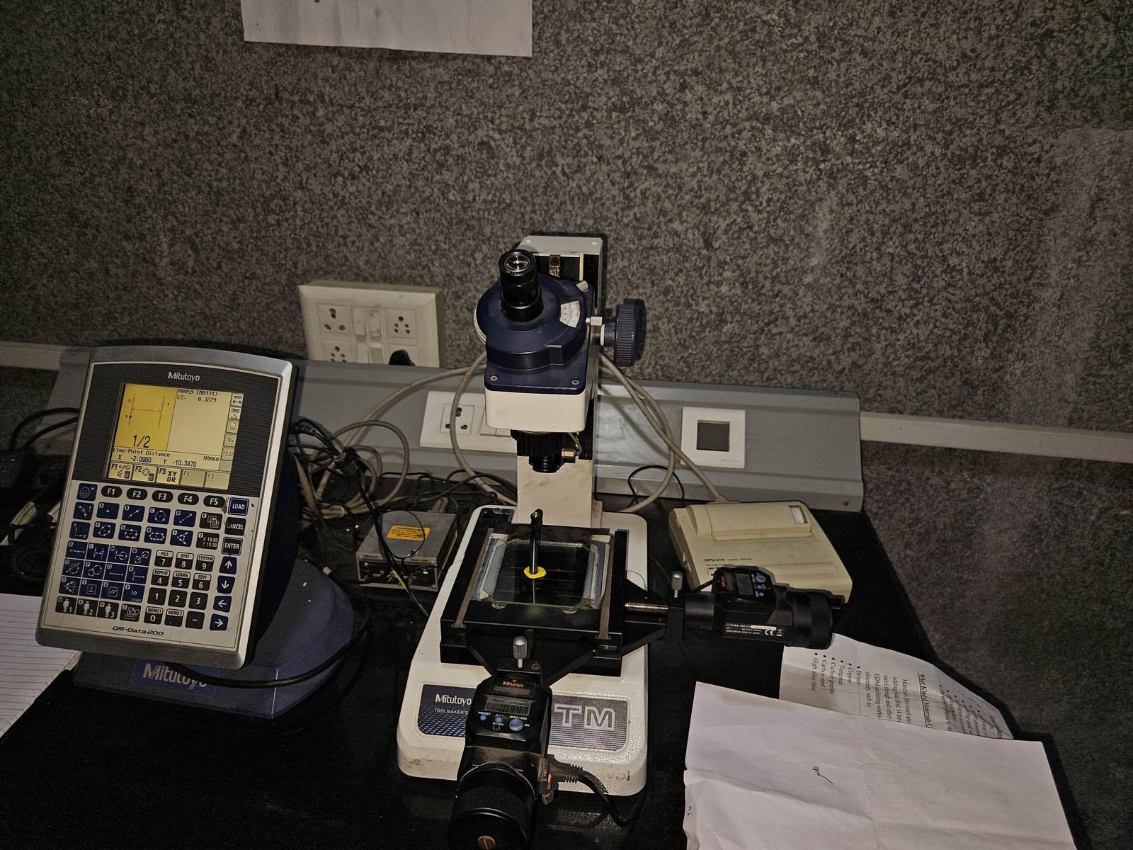
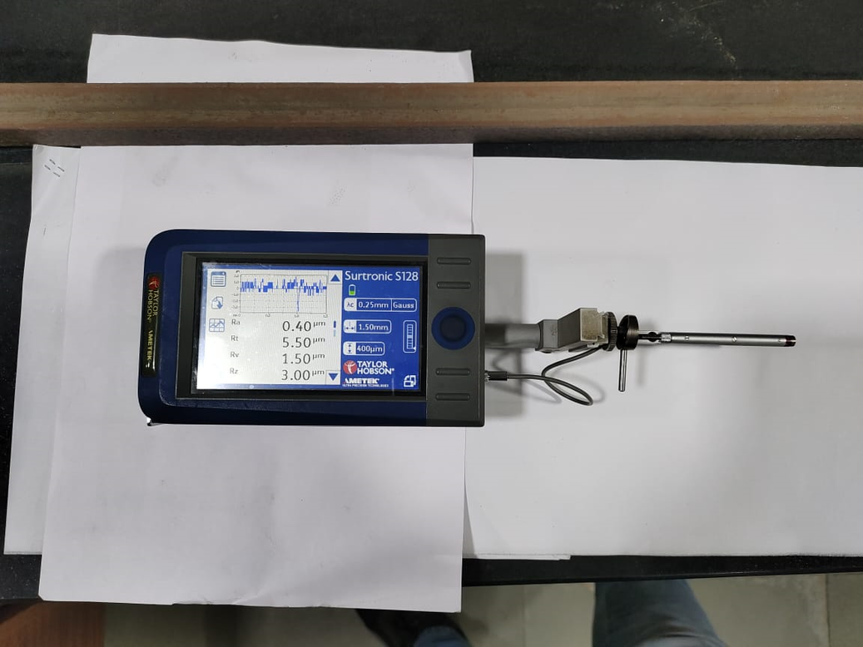
Instruments Used
Tool Maker Microscope
Taylor Hobson S-128 Surface Roughness Tester
Fig. 5
Fig. 6

Slide 8
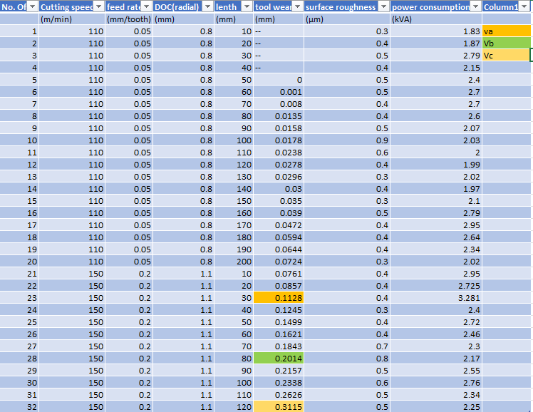
Observation Table

Slide 9
Observation Table

Slide 10
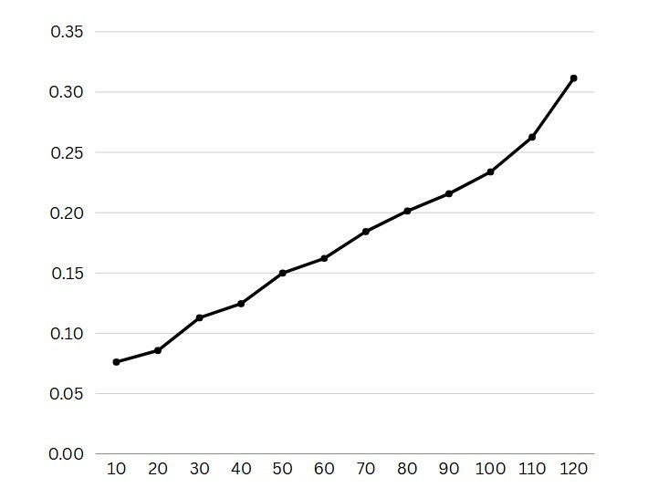
Tool Wear vs Length
Tool Wear(in mm)
Length(in mm)

Slide 11
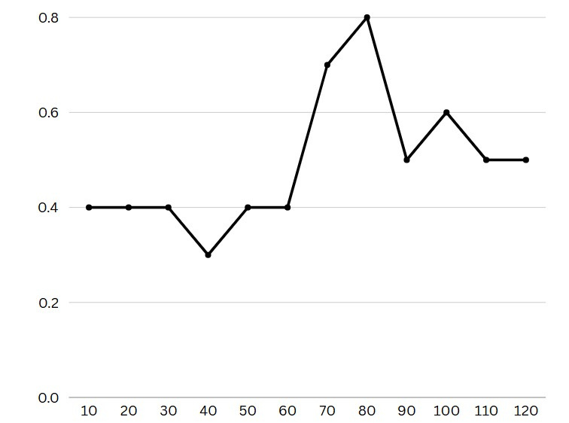
Surface Roughness vs Length
Surface Roughness(in mm)
Length(in mm)

Slide 12
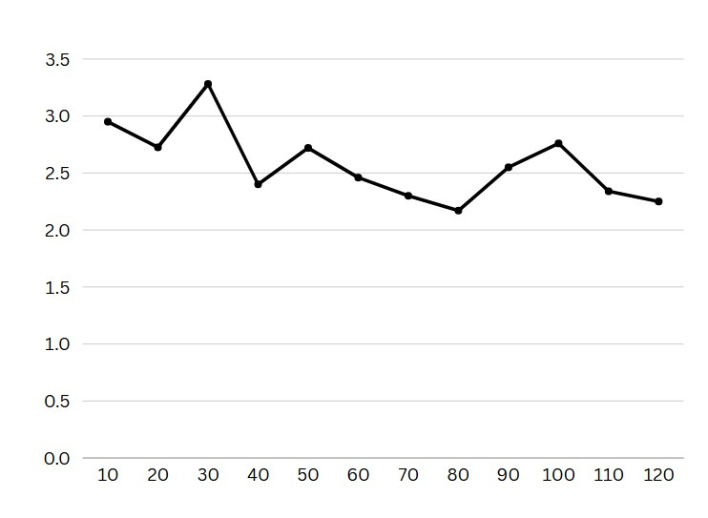
Power Consumption vs Length
Power Consumption(in kVA)
Length(in mm)

Slide 13
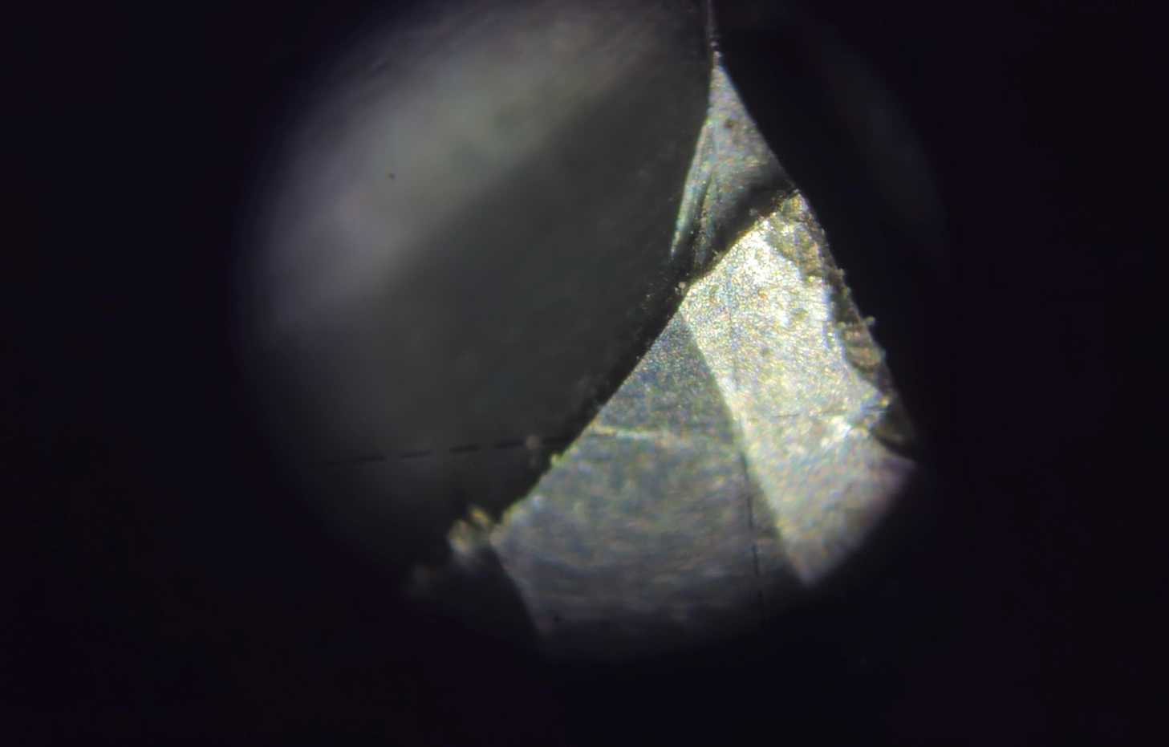
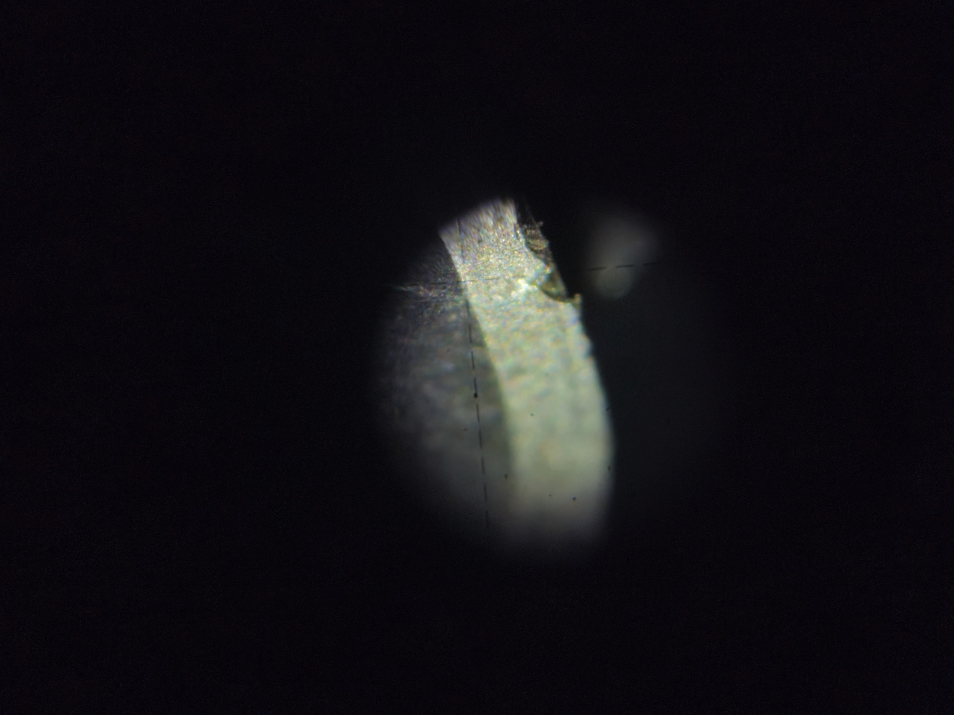
Tool Wear upto Vc(0.3 mm)
Fig. 7
Fig. 8

Slide 14
Conclusions
From the experimental view on the ball end milling ofTi-6Al-4V alloy, the following conclusions were drawn:
Tool Wear of 0.1mm (Va) is observed at length 30mm (After 3 slots)
Tool Wear of 0.2mm (Vb) is observed at length 80mm (After 8 slots)
Tool Wear of 0.3mm (Vc) is observed at length 120mm (After 12 slots)
Peak of Power is observed at Va.

Slide 15
Thankyou

